Slide 1

Instrument Recognition
DSR

Slide 2


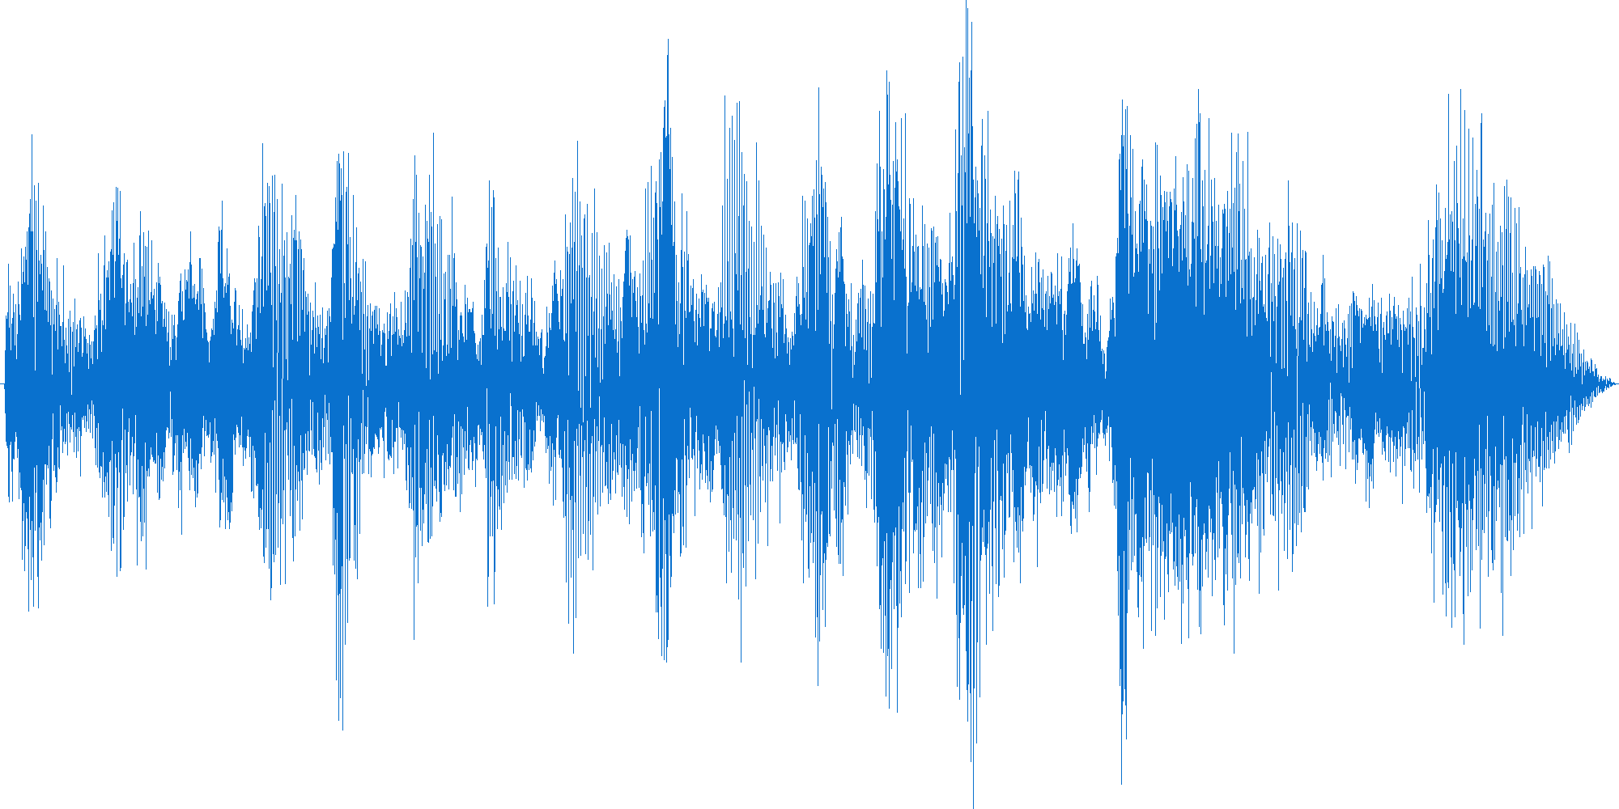





That thing can hear?
Ode an die Freude.wav

Slide 3
3 seconds
(132.000, )
:Horn
:Clarinet
:Piano
:Guitar
:Trumpet
:Flute
:Violin
:Cello
[1, 3, 2, 6, 2, 3, 4, 5, 3, 4, 6, 7 , 8, 7, 2, 4, 7, 9, 2, 1]

Slide 4
3 seconds
(132.000, )
0.0
0.1
0.1
0.1
0.1
0.1
0.4
0.1
:Horn
:Clarinet
:Piano
:Guitar
:Trumpet
:Flute
:Violin
:Cello
[1, 3, 2, 6, 2, 3, 4, 5, 3, 4, 6, 7 , 8, 7, 2, 4, 7, 9, 2, 1]

Slide 5
3 seconds
(132.000, )
0.0
0.2
0.0
0.0
0.2
0.0
0.1
0.1
0.0
0.1
0.1
0.1
0.1
0.1
0.4
0.1
:Horn
:Clarinet
:Piano
:Guitar
:Trumpet
:Flute
:Violin
:Cello
[1, 3, 2, 6, 2, 3, 4, 5, 3, 4, 6, 7 , 8, 7, 2, 4, 7]

Slide 6
3 seconds
(132.000, )
0.0
0.2
0.0
0.1
0.1
0.1
0.5
0.0
0.0
0.2
0.0
0.0
0.2
0.0
0.1
0.1
0.0
0.1
0.1
0.1
0.1
0.1
0.4
0.1
:Horn
:Clarinet
:Piano
:Guitar
:Trumpet
:Flute
:Violin
:Cello
[1, 3, 2, 6, 2, 3, 4, 5, 3, 4, 6, 7 , 8, 7]

Slide 7
3 seconds
(132.000, )
0.0
0.2
0.0
0.1
0.0
0.0
0.5
0.2
0.0
0.2
0.0
0.1
0.1
0.1
0.5
0.0
0.0
0.2
0.0
0.0
0.2
0.0
0.1
0.1
0.0
0.1
0.1
0.1
0.1
0.1
0.4
0.1
:Horn
:Clarinet
:Piano
:Guitar
:Trumpet
:Flute
:Violin
:Cello
[1, 3, 2, 6, 2, 3, 4, 5, 3, 4, 6]

Slide 8
Zu viele Noten!
3 seconds
HASH
(132.000, )
0.0
0.2
0.0
0.1
0.0
0.0
0.5
0.2
0.0
0.2
0.0
0.1
0.0
0.0
0.5
0.2
0.0
0.2
0.0
0.1
0.1
0.1
0.5
0.0
0.0
0.2
0.0
0.0
0.2
0.0
0.1
0.1
0.0
0.1
0.1
0.1
0.1
0.1
0.4
0.1
:Horn
:Clarinet
:Piano
:Guitar
:Trumpet
:Flute
:Violin
:Cello
[ 1, 3, 2]
Time

Slide 9

Same same, but different.
Grunge!
So sad!
Electric Guitars!
Ode an die Freude.wav
Sounds like Teen Spirit!

Slide 10
To train a model is like to teach a student?
IRMAS
Data Augmentation
Feature Extraction
Feature Stacking
:Horn
:Clarinet
:Piano
:Guitar
:Trumpet
:Flute
:Violin
:Cello
UIOWA
Frequency Domain
Curate
Time Domain

Slide 11
Enough of this Powerpoint thing!
IRMAS
Data Augmentation
Feature Extraction
Feature Stacking
:Horn
:Clarinet
:Piano
:Guitar
:Trumpet
:Flute
:Violin
:Cello
UIOWA
Frequency Domain
Curate
Time Domain

Slide 12
Tagging a song
IRMAS (6705)
3 seconds
Excerpts from songs
Polyphonic
Melodic
Ensemble (noise)
Label: predominant instrument
UIOWA(?)
1 to 120 seconds
Studio recording of instrument
Monophonic
Melodic (chromatic scale)
Solo Instrument (no noise)
Label: Solo instrument

Slide 13
Data cleaning / preparation
IRMAS (6705)
3 seconds
Excerpts from songs
Polyphonic
Melodic
Ensemble (Background noise)
Label: predominant instrument
UIOWA(1000)
3 seconds
Studio recording of instrument
Monophonic
Monoton (Single note)
Solo Instrument
Label: Solo instrument

